Slide 1

ER-to-Relational Model Mapping
Content Sources:
Elamsari and Navathe, Fundamentals of Database Management systems

Slide 2
ER-to-Relational Mapping Algorithm
Step 1: Mapping of Regular Entity Types
Step 2: Mapping of Weak Entity Types
Step 3: Mapping of Binary 1:1 Relation Types
Step 4: Mapping of Binary 1:N Relationship Types.
Step 5: Mapping of Binary M:N Relationship Types.
Step 6: Mapping of Multivalued attributes.
Step 7: Mapping of N-ary Relationship Types.

Slide 3
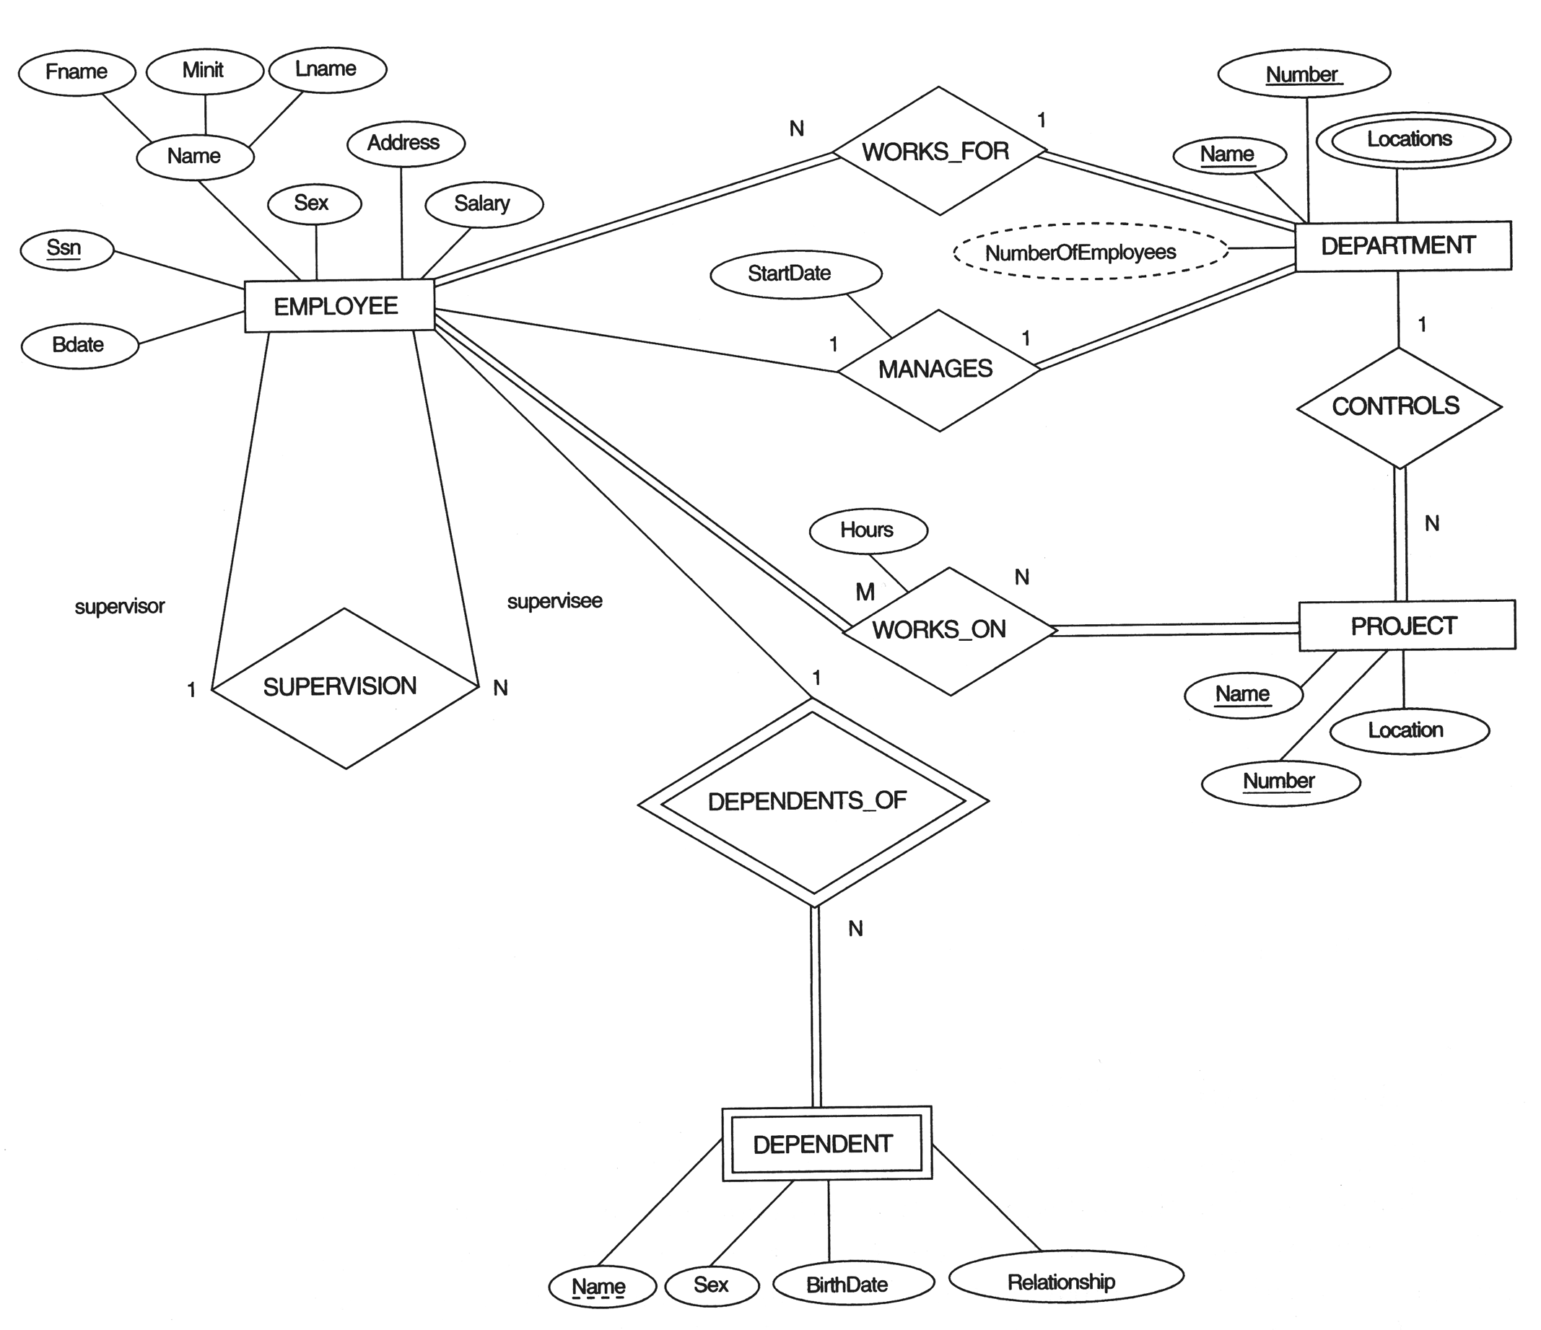

Slide 4
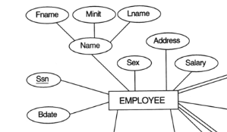

Step 1: Mapping of Regular Entity Types.
Convert each regular (strong) entity type E = relation R with simple attributes of E.
One of the Key attributes of E =primary key for R.
(If the chosen key of E is composite then it will be composite in R.)
Example: We create the relations EMPLOYEE, DEPARTMENT, and PROJECT in the relational schema corresponding to the regular entities in the ER diagram. SSN, DNUMBER, and PNUMBER are the primary keys for the relations EMPLOYEE, DEPARTMENT, and PROJECT as shown.

Slide 5
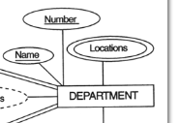

Department table
Note: Multi valued Attributes are considered in further steps

Slide 6
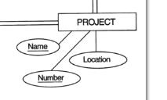

Project table

Slide 7
Step 2: Mapping of Weak Entity Types
A weak entity type W with owner entity type E= A relation R including all simple attributes of W as attributes of R.
Foreign key of R=Primary key attribute(s) of the relation(s) that correspond to the owner entity type(s).
The primary key of R= primary key(s) of the owner + the partial key of the weak entity type W
Example: Create the relation DEPENDENT in this step to correspond to the weak entity type DEPENDENT. Include the primary key SSN of the EMPLOYEE relation as a foreign key attribute of DEPENDENT (renamed to ESSN).
The primary key of the DEPENDENT relation is the combination {ESSN, DEPENDENT_NAME} because DEPENDENT_NAME is the partial key of DEPENDENT.

Slide 9
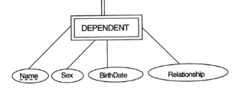

Step 2: Mapping of Weak Entity Types
Primary key of owner
Partial key of Weak Entity
Note: Renaming of keys is optional but preferable.

Slide 10
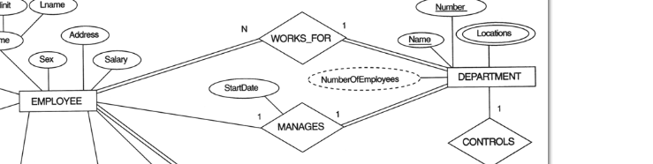

Step 3: Mapping of Binary 1:1 Relation Types
For each binary 1:1 relationship type R in the ER schema, there are three possible approaches:
(1) Foreign Key approach: Choose one of the relations-S, say-and include a foreign key in S the primary key of T. (Better choose an entity with total participation in R in the role of S) Example: 1:1 relation MANAGES is mapped by choosing the participating entity type DEPARTMENT to serve in the role of S, because its participation in the MANAGES relationship type is total.
Emp - Dept(1:1)
Total participation

Slide 11
Step 3: Mapping of Binary 1:1 Relation Types
(2) Merged relation option: An alternate mapping of a 1:1 relationship type is possible by merging the two entity types and the relationship into a single relation. This may be appropriate when both participations are total.
(3) Cross-reference or relationship relation option: The third alternative is to set up a third relation R for the purpose of cross-referencing the primary keys of the two relations S and T representing the entity types.

Slide 12
Step 4: Mapping of Binary 1:N Relationship Types.
For each regular binary 1:N relationship type R, identify the relation S that represent the participating entity type at the N-side of the relationship type.
Include as foreign key in S the primary key of the relation T that represents the other entity type participating in R.
Include any simple attributes of the 1:N relation type as attributes of S.
Example: 1:N relationship types WORKS_FOR, CONTROLS, and SUPERVISION in the figure. For WORKS_FOR we include the primary key DNUMBER of the DEPARTMENT relation as foreign key in the EMPLOYEE relation and call it DNO.

Slide 13
SuperSSN as Foreign Key
Dnumber as foreign Key
Dnum as Foreign Key

Slide 14
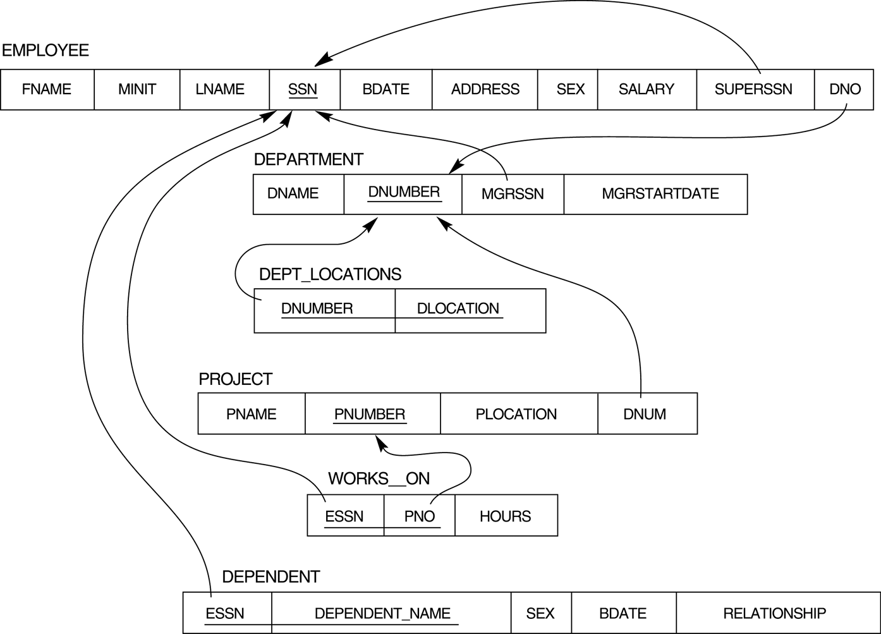
PK(Dnumber)=
FK(Dno)
PK(SSN)=
FK(SuperSSN)
PK(DNUMBER)=FK(DNUM)

Slide 15
Step 4: Mapping of Binary 1:N Relationship Types
PARTICIPATION type:
TOTAL participation the “many” side, the extra attribute added to the “many” side containing the primary key of the “one” side, will contain NOT NULL values.
In PARTIAL participation, on many” side the extra attribute added to the “many” side containing the primary key of the “one” side, could result in NULL values

Slide 16
Step 5: Mapping of Binary M:N Relationship Types
Each binary M:N relationship type R= new relation S to represent R.
Include as foreign key attributes in S the primary keys of the relations that represent the participating entity types; their combination will form the primary key of S.
Also include any simple attributes of the M:N relationship type (or simple components of composite attributes) as attributes of S.
Example: The M:N relationship type WORKS_ON from the ER diagram is mapped by creating a relation WORKS_ON in the relational database schema. The primary keys of the PROJECT and EMPLOYEE relations are included as foreign keys in WORKS_ON and renamed PNO and ESSN, respectively.
Attribute HOURS in WORKS_ON represents the HOURS attribute of the relation type. The primary key of the WORKS_ON relation is the combination of the foreign key attributes {ESSN, PNO}.

Slide 18
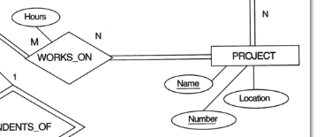

Step 5: Mapping of Binary M:N Relationship Types

Slide 19
Step 6: Mapping of Multivalued attributes.
Each multivalued attribute A= new relation R( MV Attribute+ the primary key attribute K-as a foreign key in R-of the relation that represents the entity type of relationship type that has A as an attribute)
If the multivalued attribute is composite, we include its simple components.
Example: The relation DEPT_LOCATIONS is created. The attribute DLOCATION represents the multivalued attribute LOCATIONS of DEPARTMENT, while DNUMBER-as foreign key-represents the primary key of the DEPARTMENT relation. The primary key of R is the combination of {DNUMBER, DLOCATION}.

Slide 20
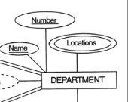

Step 6: Mapping of Multivalued attributes.

Slide 21
FIGURE 7.2 Result of mapping the COMPANY ER schema into a relational schema.

Slide 22
Step 7: Mapping of N-ary Relationship Types.
For each n-ary relationship type R, where n>2, create a new relationship S to represent R.
Include as foreign key attributes in S the primary keys of the relations that represent the participating entity types.
Also include any simple attributes of the n-ary relationship type (or simple components of composite attributes) as attributes of S.
Example: The relationship type SUPPY in the ER below. This can be mapped to the relation SUPPLY shown in the relational schema, whose primary key is the combination of the three foreign keys {SNAME, PARTNO, PROJNAME}

Slide 23
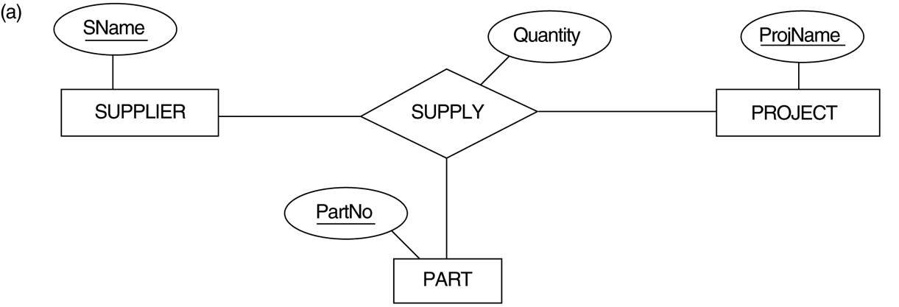
FIGURE 4.11 Ternary relationship types. (a) The SUPPLY relationship.

Slide 24
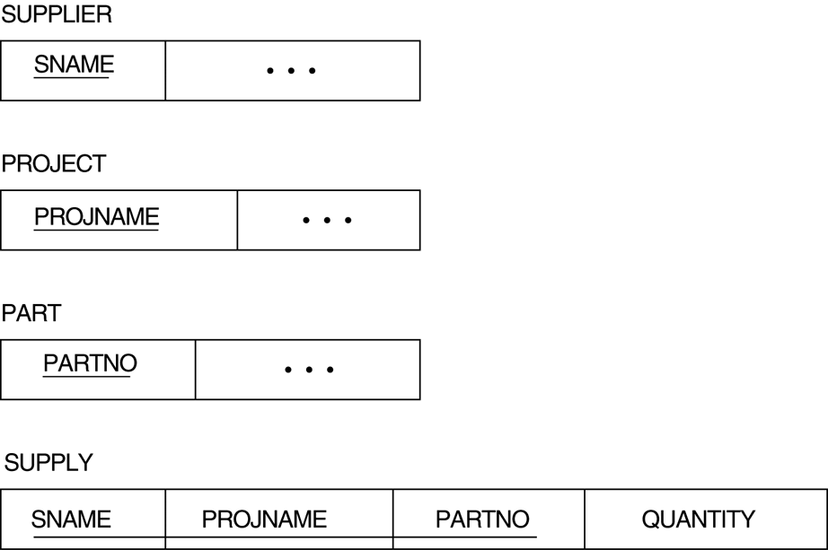
FIGURE 7.3 Mapping the n-ary relationship type SUPPLY from Figure 4.11a.

Slide 25
Summary of Mapping constructs and constraints
Table 7.1 Correspondence between ER and Relational Models
ER Model Relational Model
Entity type “Entity” relation
1:1 or 1:N relationship type Foreign key (or “relationship” relation)
M:N relationship type “Relationship” relation and two foreign keys
n-ary relationship type “Relationship” relation and n foreign keys
Simple attribute Attribute
Composite attribute Set of simple component attributes
Multivalued attribute Relation and foreign key
Value set Domain
Key attribute Primary (or secondary) key

Slide 26
Mapping EER Model Constructs to Relations Step8: Options for Mapping Specialization or Generalization
Assumptions:
subclasses ->{S₁, S₂,….,S_{m}}
generalized superclass ->C{ k,a₁,…a_{n}}
k is Primary key

Slide 27
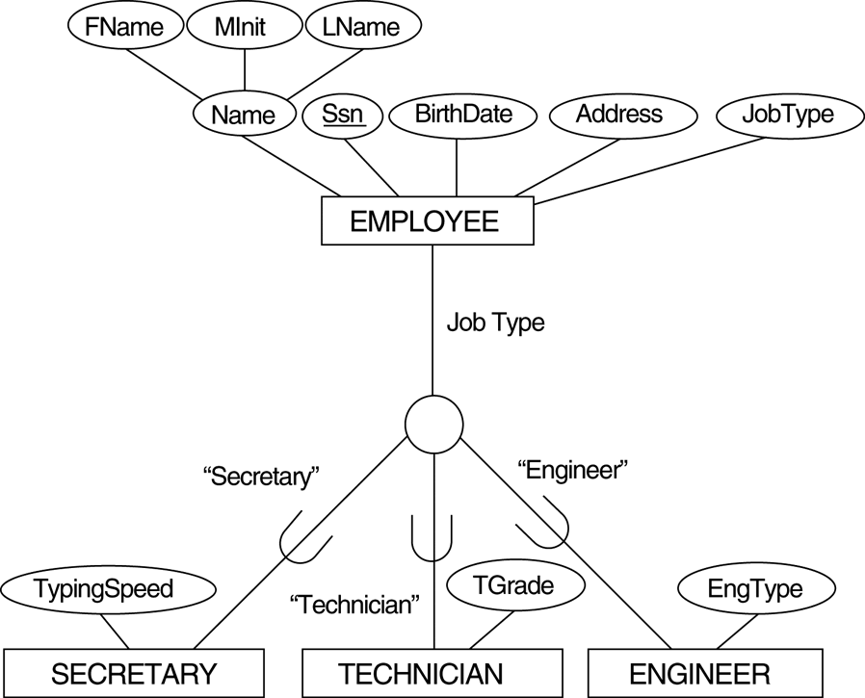
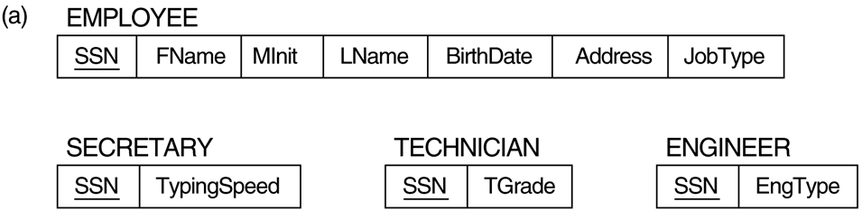
Option 8A: Multiple relations-Superclass and subclasses.
Create a relation L for C with attributes Attrs(L) = {k,a₁,…a_{n}} and PK(L) = k.
Create a relation L_{i} for each subclass S_{i}, 1 < i < m, with the attributes
Attrs(L_{i}) = {k} U {attributes of S_{i}} and PK(L_{i})=k.
Note: This option works for any specialization (total or partial, disjoint of over-lapping).

Slide 28
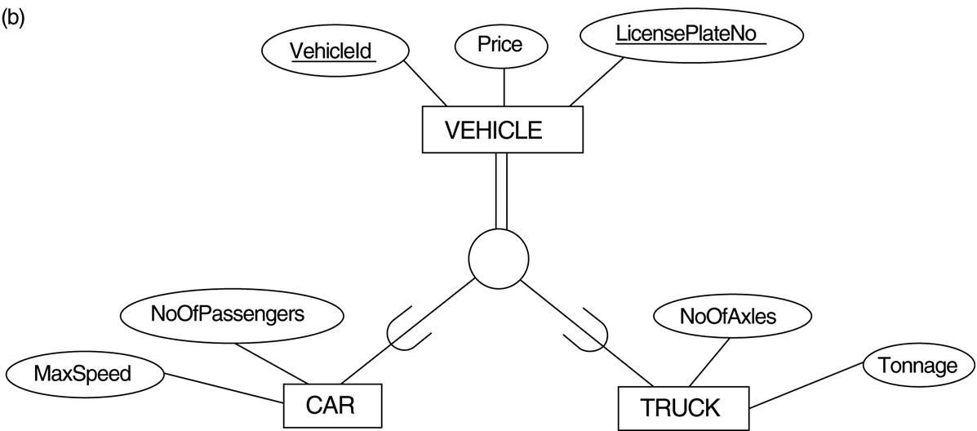
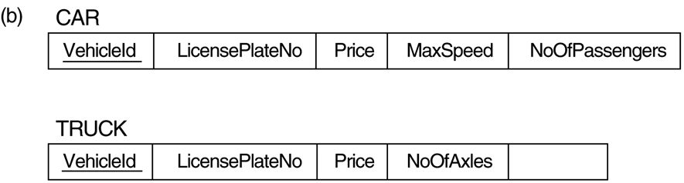
Option 8B: Multiple relations-Subclass relations only
Create a relation L_{i} for each subclass S_{i}, 1 < i < m, with the attributes
Attr(L_{i}) = {attributes of S_{i}} U {k,a₁…,a_{n}} and PK(L_{i}) = k.
Note: Only works for a specialization whose subclasses are total (every entity in the superclass must belong to (at least) one of the subclasses).

Slide 29
Option 8C: Single relation with one type attribute
Create a single relation L with attributes
Attrs(L) = {k,a₁,…a_{n}} U {attributes of S₁} U…U {attributes of S_{m}} U {t} and PK(L) = k.
Note: The attribute t is called a type (or discriminating) attribute that indicates the subclass to which each tuple belongs

Slide 30
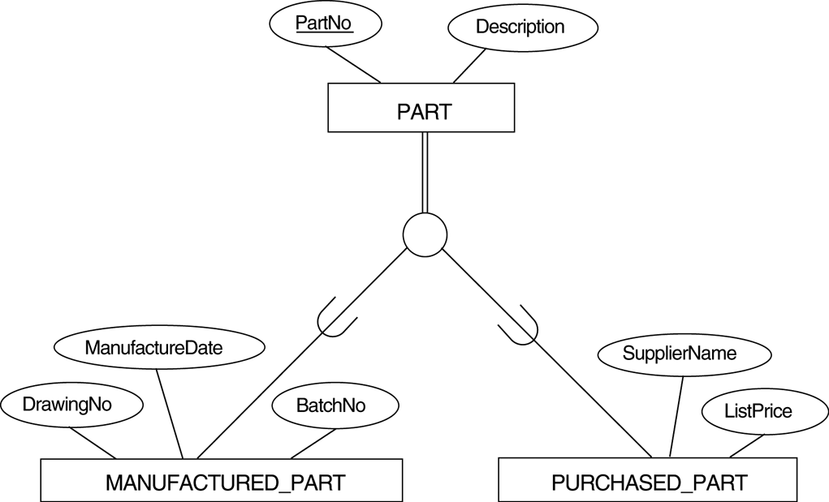
Option 8D: Single relation with multiple type attributes.
Create a single relation schema L with attributes
Attrs(L) = {k,a₁,…a_{n}} U {attributes of S₁} U…U {attributes of S_{m}} U {t₁, t₂,…,t_{m}} and PK(L) = k.
Each t_{i}, 1 < I < m, is a Boolean type attribute indicating whether a tuple belongs to the subclass S_{i}.
Boolean Flags

Slide 31
Mapping of Shared Subclasses (Multiple Inheritance)
A shared subclass, such as STUDENT_ASSISTANT, is a subclass of several classes, indicating multiple inheritance. These classes must all have the same key attribute; otherwise, the shared subclass would be modeled as a category.
We can apply any of the options discussed in Step 8 to a shared subclass, subject to the restriction discussed in Step 8 of the mapping algorithm. Below both 8C and 8D are used for the shared class STUDENT_ASSISTANT.

Slide 32
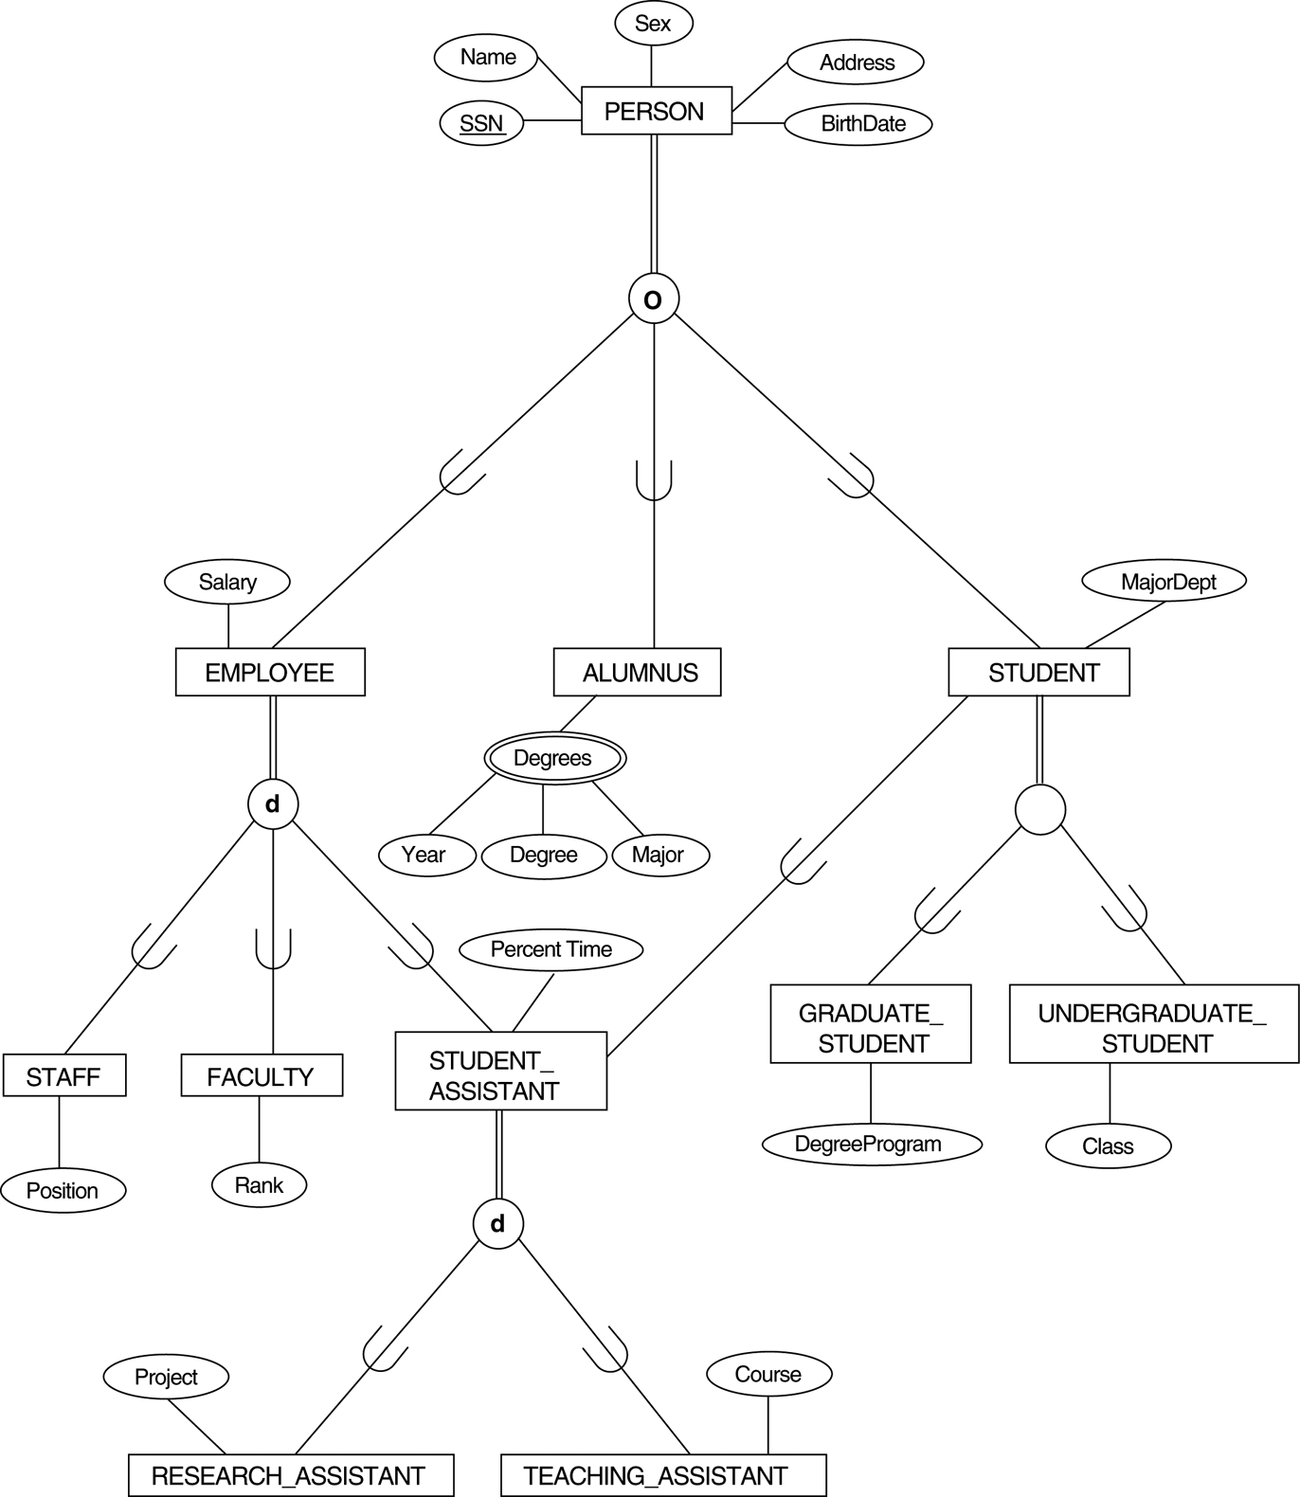
FIGURE 4.7 A specialization lattice with multiple inheritance for a UNIVERSITY database.

Slide 33
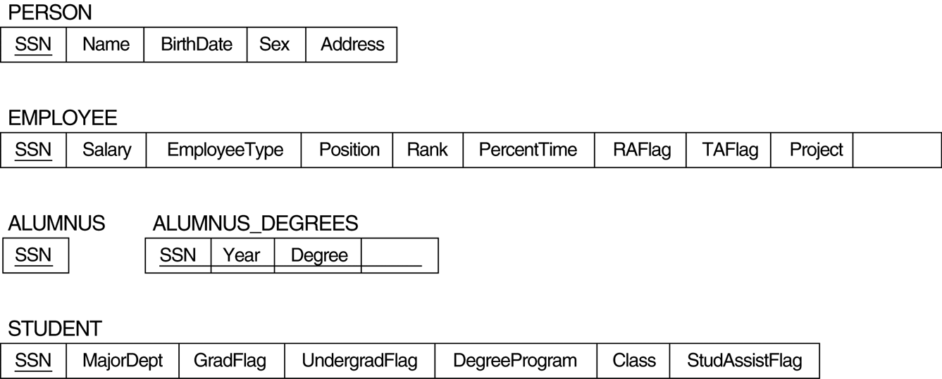
FIGURE 7.5 Mapping the EER specialization lattice in Figure 4.6 using multiple options.

Slide 34
Step 9: Mapping of Union Types (Categories)
For mapping a category whose defining superclass have different keys, it is customary to specify a new key attribute, called a surrogate key, when creating a relation to correspond to the category.
In the example below we can create a relation OWNER to correspond to the OWNER category and include any attributes of the category in this relation. The primary key of the OWNER relation is the surrogate key, which we called OwnerId.

Slide 35
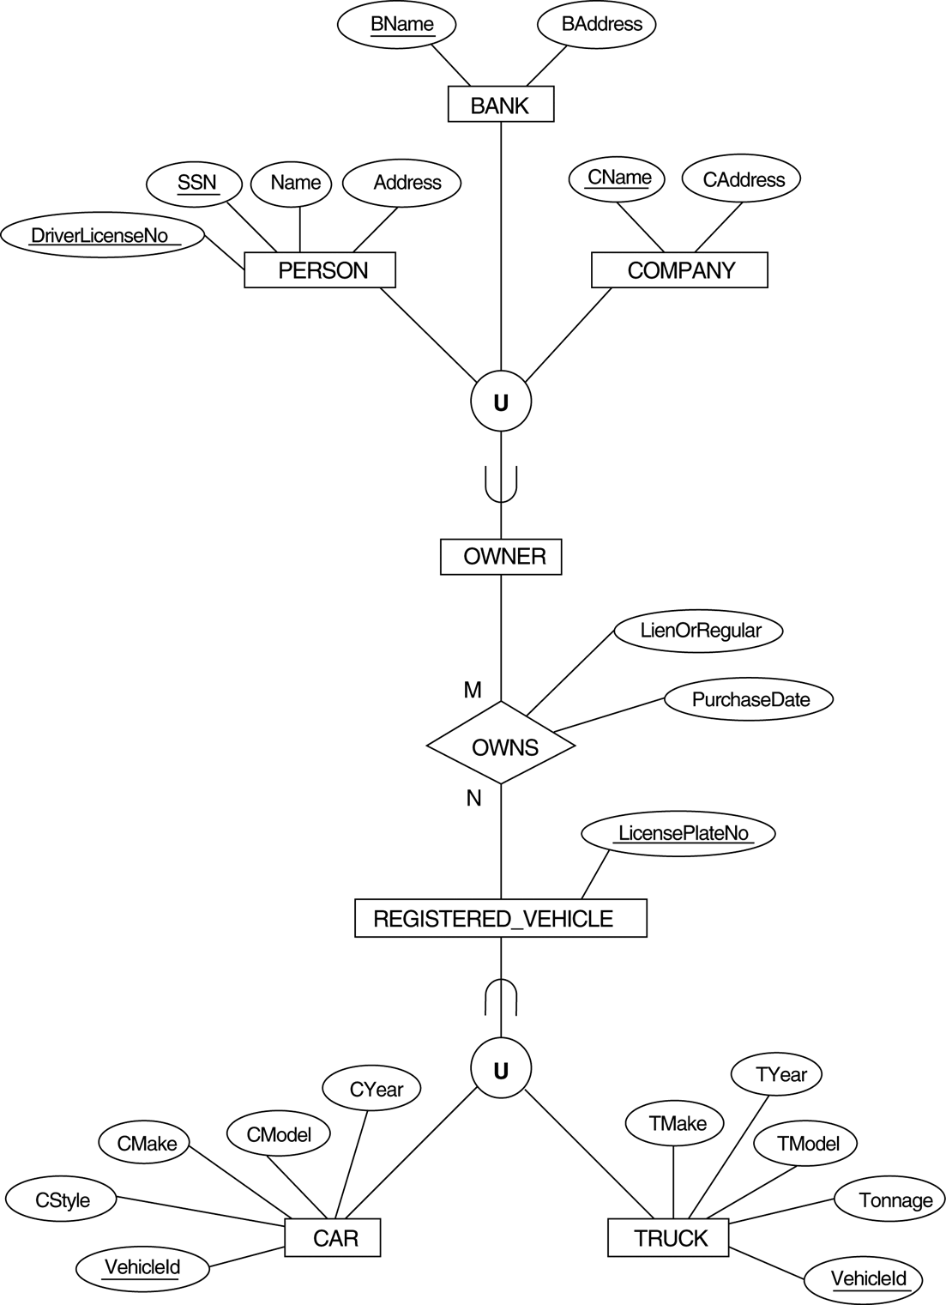
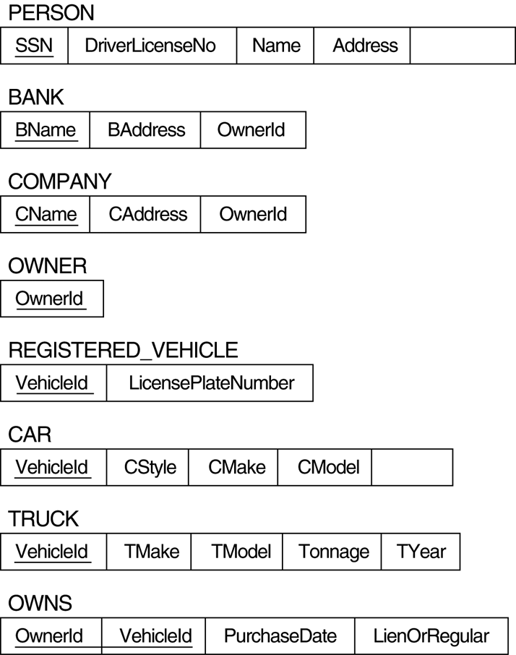

Slide 36
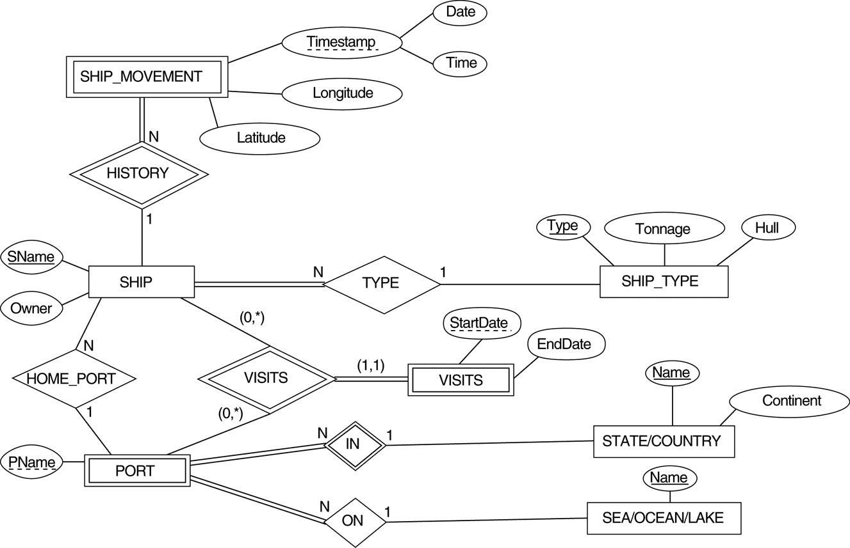
Mapping Exercise
Exercise 7.4.
FIGURE 7.7 An ER schema for a SHIP_TRACKING database.

Slide 37
Thankyou

